Slide 1
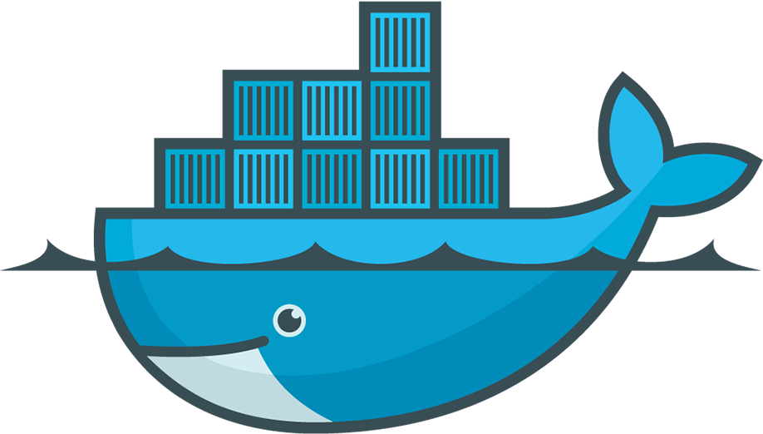
Getting Start With Docker
Chapter Two

Slide 2
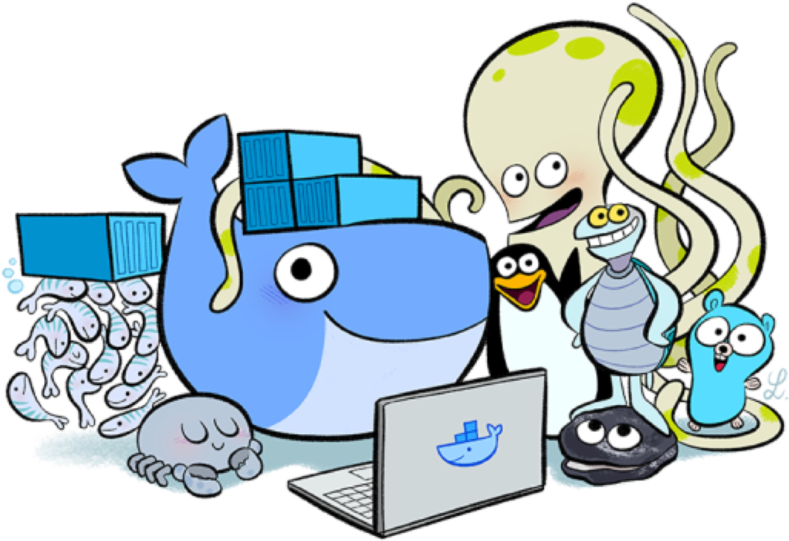
Objective
What is Docker?
Docker CLI
Docker CLI Basics
Docker CLI Takeaways
Docker CLI Further Reading
Docker Data Management
Docker Networking

Slide 3
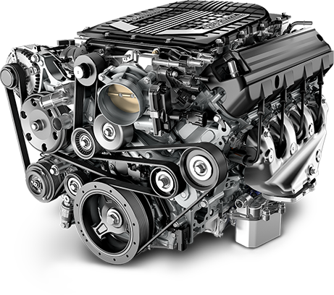
What is Docker?
Explain
Docker is an open platform for developing, shipping, and running applications. Docker engine is a lightweight container runtime that provides the workflow for building and running your applications as containers. There are two editions:
Community Edition (CE)
Enterprise Edition (EE)

Slide 4
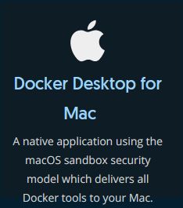
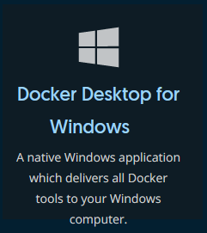
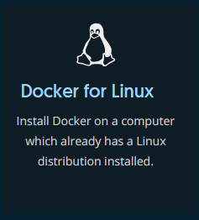
What is Docker?
Explain
Get your Docker Platforms:
Reference: https://docs.docker.com/get-docker/

Slide 5
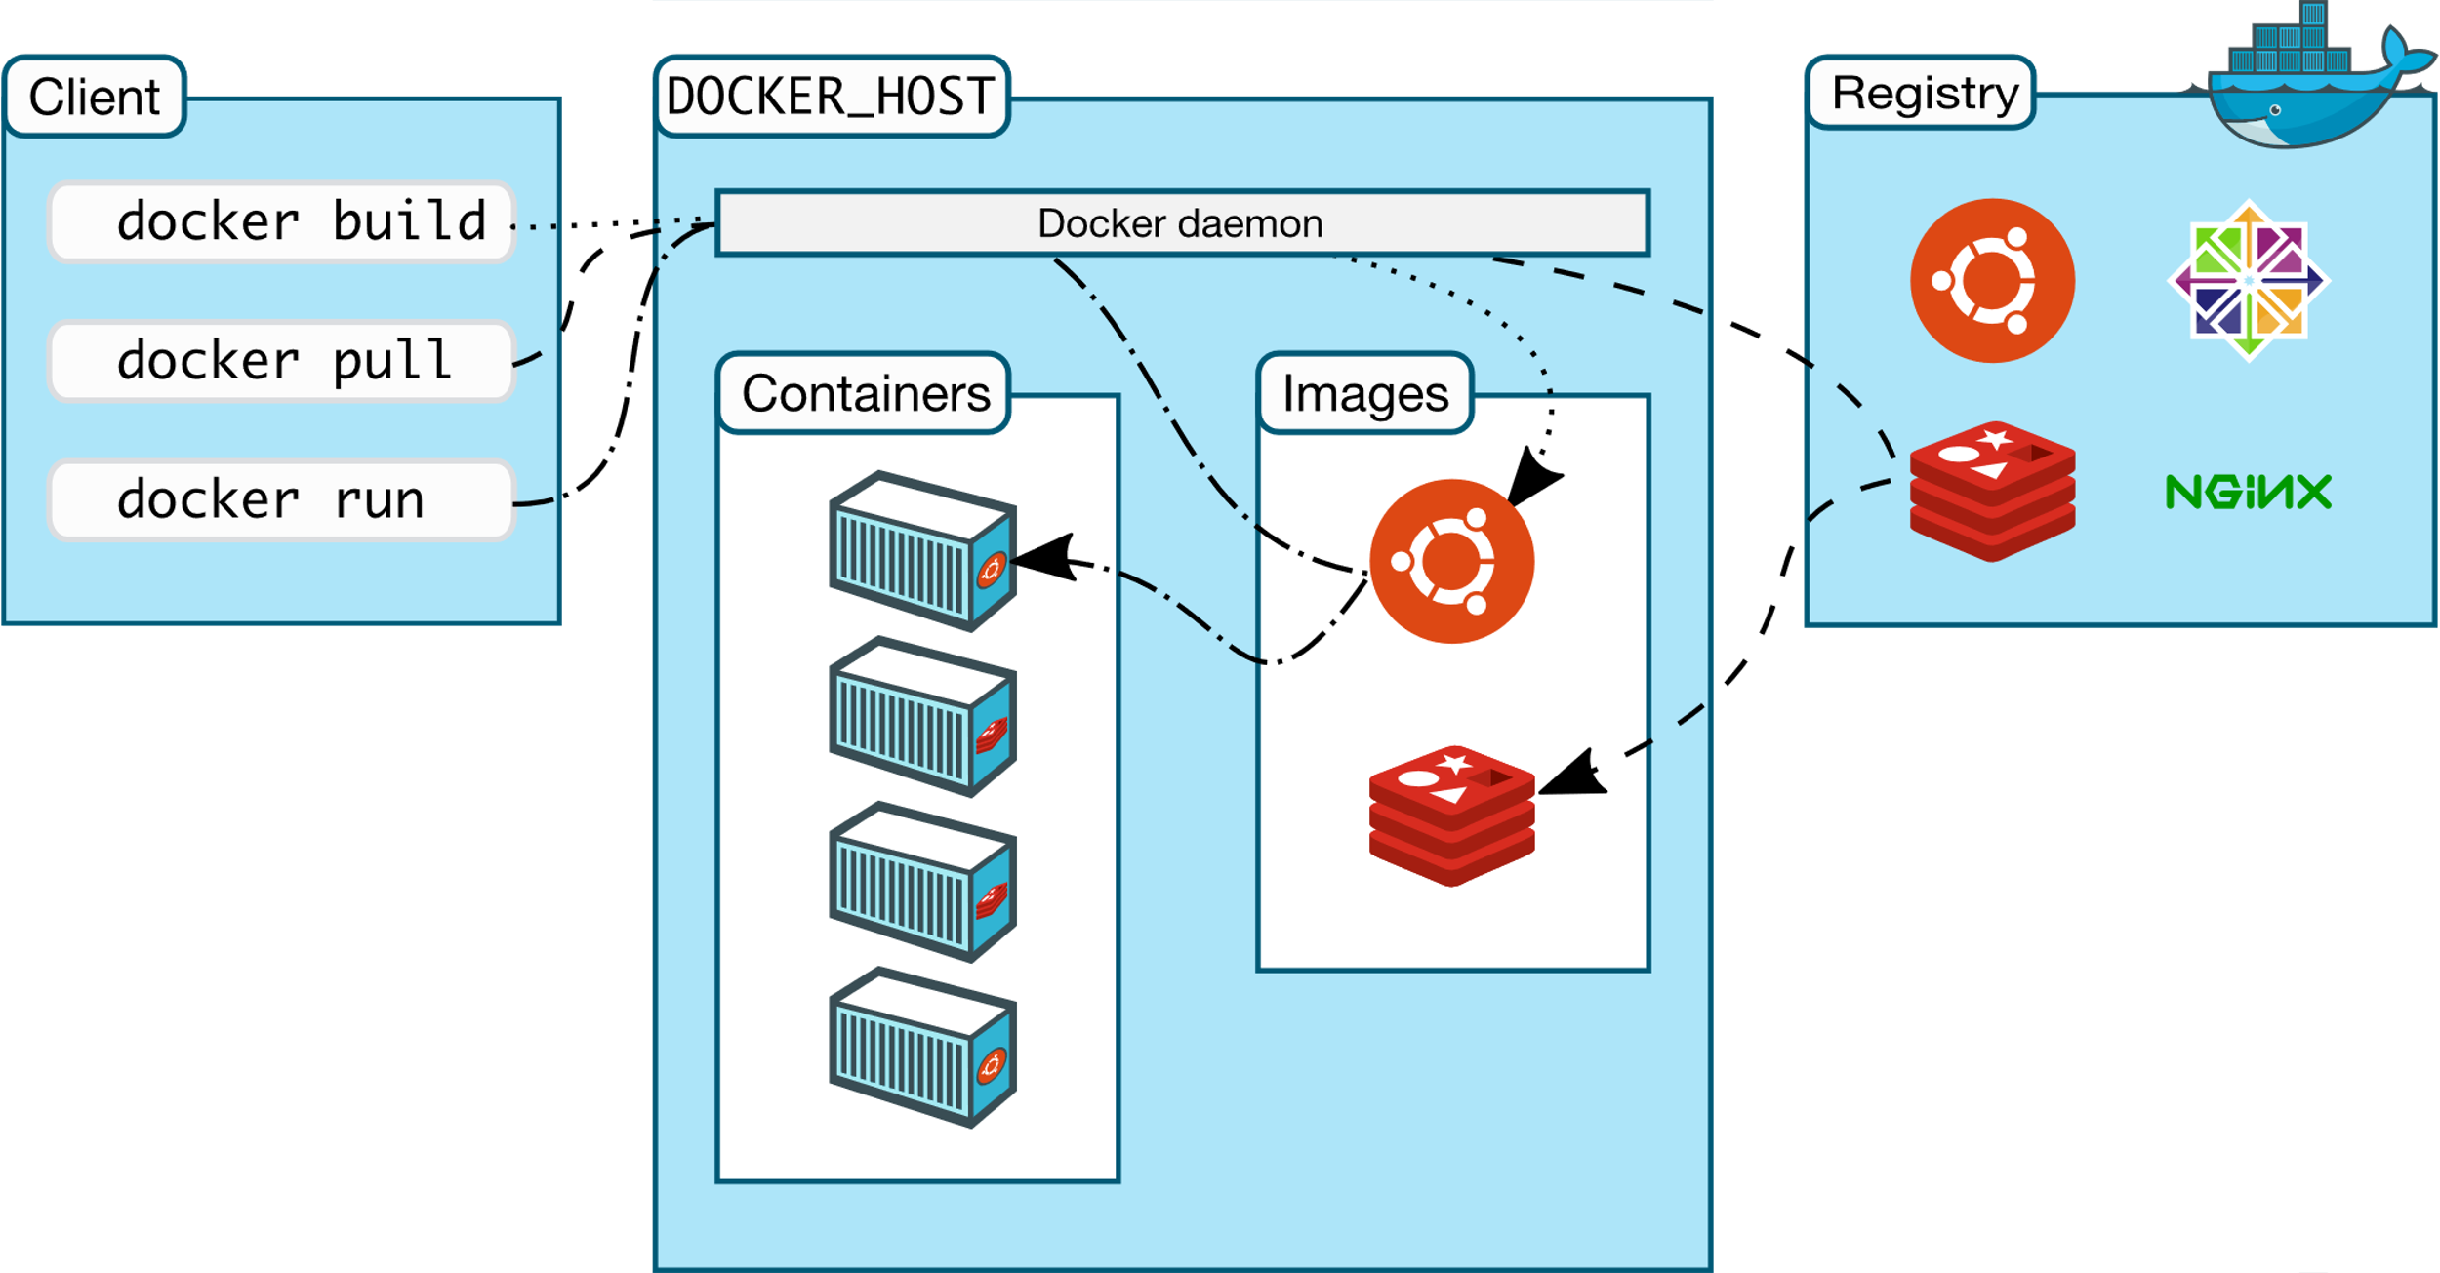
What is Docker?
Explain
Docker Architecture
Reference: https://docs.docker.com/get-started/overview/#docker-architecture

Slide 6
What is Docker?
Docker Architecture:
The Docker daemon (dockerd) listens for Docker API requests and manages Docker objects such as images, containers, networks, and volumes.
The Docker client (docker) is the primary way that many Docker users interact with Docker. When you use commands such as docker run, the client sends these commands to dockerd, which carries them out. The docker command uses the Docker API.
Docker registries stores Docker images. Docker Hub is a public registry that anyone can use, and Docker is configured to look for images on Docker Hub by default. You can even run your own private registry.
Docker Objects
Images (a read-only template)
Containers (a runnable instance of an image)
Networks
Volumes
…
Explain
Reference: https://docs.docker.com/get-started/overview/#docker-architecture
Notes:
The Docker daemon (dockerd) listens for Docker API requests and manages Docker objects such as images, containers, networks, and volumes. A daemon can also communicate with other daemons to manage Docker services.
The Docker client (docker) is the primary way that many Docker users interact with Docker. When you use commands such as docker run, the client sends these commands to dockerd, which carries them out. The docker command uses the Docker API. The Docker client can communicate with more than one daemon.
A Docker registry stores Docker images. Docker Hub is a public registry that anyone can use, and Docker is configured to look for images on Docker Hub by default. You can even run your own private registry. When you use the docker pull or docker run commands, the required images are pulled from your configured registry. When you use the docker push command, your image is pushed to your configured registry.
Docker objects:
Images a read-only template with instructions for creating a Docker container. Often, an image is based on another image, with some additional customization. For example, you may build an image which is based on the ubuntu image, but installs the Apache web server and your application, as well as the configuration details needed to make your application run.
Containers is a runnable instance of an image. You can create, start, stop, move, or delete a container using the Docker API or CLI. You can connect a container to one or more networks, attach storage to it, or even create a new image based on its current state. By default, a container is relatively well isolated from other containers and its host machine. You can control how isolated a container’s network, storage, or other underlying subsystems are from other containers or from the host machine. A container is defined by its image as well as any configuration options you provide to it when you create or start it. When a container is removed, any changes to its state that are not stored in persistent storage disappear.

Slide 7
Docker CLI
Explain
Docker CLI is the client-side component of Docker engine which developers, administrators and systems alike use to interact with the engine.
NOTE: The CLI and Engine are distributed as a single unit.

Slide 8
Docker CLI Basics
Practice
We will now work through how to do the following:
● Running and Inspecting a Container
● Interact with Containers
● Analyze Container Logs
● Start, Stop, Inspect and Delete Containers
Exercise 4 in ‘Docker Fundamentals for Linux Exercises’

Slide 9
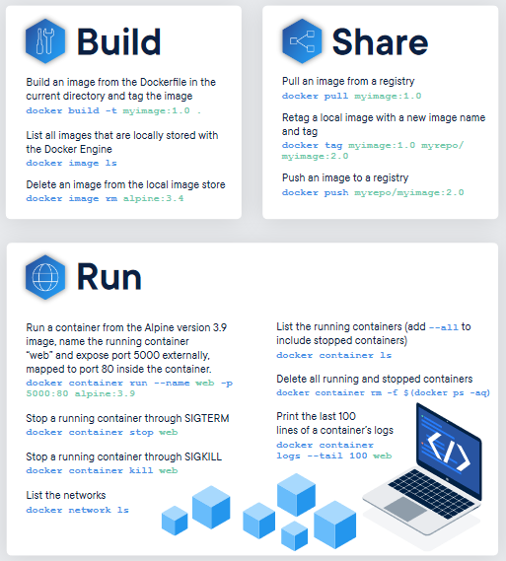
Docker CLI Takeaways
Practice
● docker container run
● docker container rm
● docker container start
● docker container stop
● docker container kill
● docker container exec
● docker container logs
● docker container inspect
● docker container ls
https://dockerlabs.collabnix.com/docker/cheatsheet/

Slide 10
Docker CLI Further Reading
● List of container commands: https://docs.docker.com/engine/reference/commandline/container/
● Getting started with containers:
https://docs.docker.com/get-started/part2/
● Start containers automatically:
https://docs.docker.com/config/containers/start-containers-automatically/
● Resource limits for containers: https://docs.docker.com/config/containers/resource_constraints/
● HA containers:
https://docs.docker.com/config/containers/live-restore/
● Container isolation:
https://docs.docker.com/engine/security/userns-remap/

Slide 11
Docker Data Management
By default, all files created inside a container are stored on a writable container layer. This means that:
The data doesn’t persist when that container no longer exists
You can’t easily move the data somewhere else
Docker has two options for containers to store files in the host machine:
Named Volumes
Bind Mounts
Notes:
By default all files created inside a container are stored on a writable container layer. This means that:
The data doesn’t persist when that container no longer exists, and it can be difficult to get the data out of the container if another process needs it.
A container’s writable layer is tightly coupled to the host machine where the container is running. You can’t easily move the data somewhere else.
Writing into a container’s writable layer requires a storage driver to manage the filesystem. The storage driver provides a union filesystem, using the Linux kernel. This extra abstraction reduces performance as compared to using data volumes, which write directly to the host filesystem.
Docker has two options for containers to store files in the host machine, so that the files are persisted even after the container stops: volumes, and bind mounts. If you’re running Docker on Linux you can also use a tmpfs mount. If you’re running Docker on Windows you can also use a named pipe.
Keep reading for more information about these two ways of persisting data.

Slide 12
Docker Data Management
Choose the right type of mount:
Volumes
Stored in /var/lib/docker/volumes/ (on Linux)
Created and managed by Docker or explicitly using the (docker volume opts)
Bind mounts
May be stored anywhere on the host system/shared storage
Mostly used for containers sharing data between multi–Docker Hosts (High Availability/Clustering setup)
A file or directory on the host machine is mounted into a container
Tmpfs mounts (Linux) / Named pipes (Windows)
Stored in the host system’s memory only
Can be used by a container during the lifetime of the container to store non-persistent state or sensitive information.
https://docs.docker.com/storage/
Notes:
Volumes are stored in a part of the host filesystem which is managed by Docker (/var/lib/docker/volumes/ on Linux). Non-Docker processes should not modify this part of the filesystem. Volumes are the best way to persist data in Docker.
Bind mounts may be stored anywhere on the host system. They may even be important system files or directories. Non-Docker processes on the Docker host or a Docker container can modify them at any time.
tmpfs mounts are stored in the host system’s memory only, and are never written to the host system’s filesystem.

Slide 13
Docker Networking
Docker Networking is to connect the Docker Containers to each other and outside world so they can communicate with each other also they can talk to Docker Host. Docker’s networking subsystem is pluggable, using drivers:
Bridge
Host
Overlay
Macvlan
None
Network plugins
https://docs.docker.com/network/

Slide 14
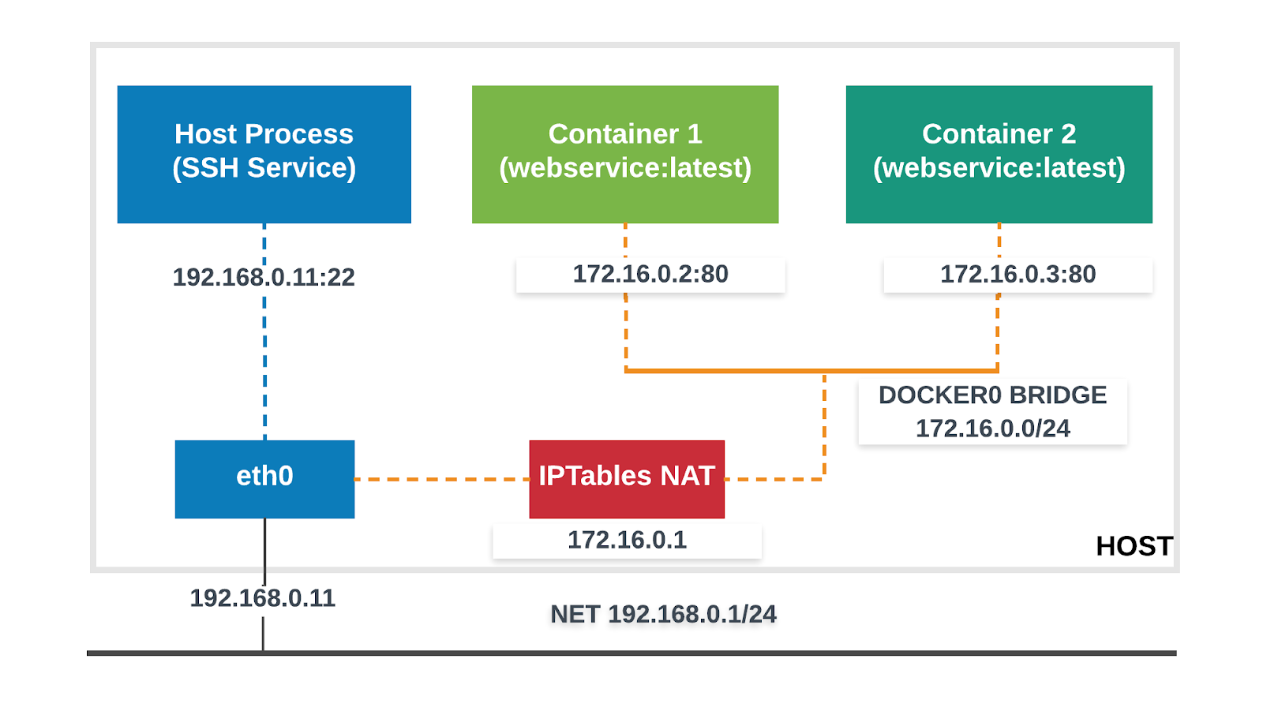
Docker Networking
Bridge Networking
Default network crated automatically when you deploy a container (i.e: docker0)
Automatically forwards packets between any other attached network interfaces
This mode put container on a separated network namespace, and sharing the external IP of host among many containers through the use of NAT.
Notes:
Reference: https://k21academy.com/docker-kubernetes/docker-networking-different-types-of-networking-overview-for-beginners/
https://medium.com/@jamesemyn/basic-docker-networking-9130ab889359
Bridge Mode Networking
The Docker daemon creates virtual ethernet bridge docker0, that automatically forwards packets between any other attached network interfaces. By default, all containers on a host will be connected to internal network. This mode put the container on a separated network namespace, and sharing the external IP address of the host amongst the many containers through the use of Network Address Translation.

Slide 15
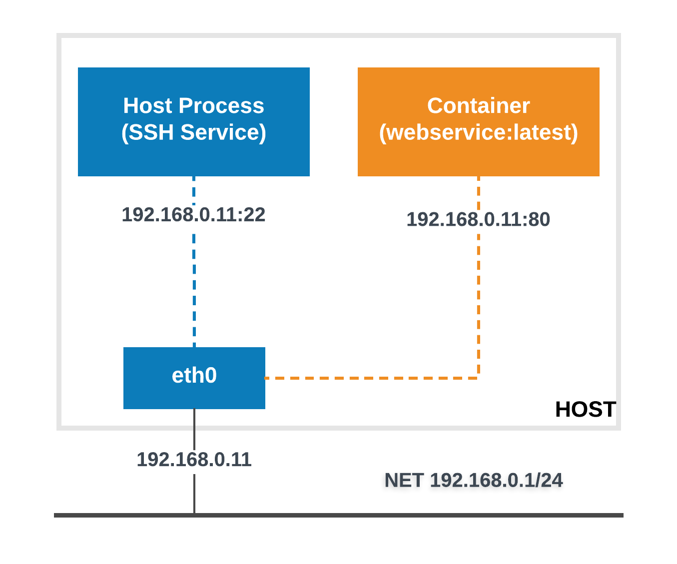
Docker Networking
Host Networking
For standalone containers
Remove network isolation between the container and the Docker host
Use the host’s networking directly
Directly exposed to the public network
It will use the host’s IP address and host’s TCP port space to expose the service running inside the container
Notes:
Reference: https://k21academy.com/docker-kubernetes/docker-networking-different-types-of-networking-overview-for-beginners/
https://medium.com/@jamesemyn/basic-docker-networking-9130ab889359
Host Mode Networking
This mode allow the container shares the networking namespace of the host, it is directly exposed to the public network. It will use the host’s IP address and host’s TCP port space to expose the service running inside the container.

Slide 16
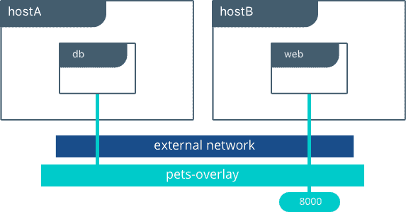
Docker Networking
Overlay Networking
Connect multiple Docker daemon together and enable swarm services to communicate with each other
Facilitate communication between a swarm service vs standalone container, or between two standalone containers on different Docker daemons.
Encrypted with AES algorithm by default.
Notes:
Reference: https://k21academy.com/docker-kubernetes/docker-networking-different-types-of-networking-overview-for-beginners/
https://medium.com/@jamesemyn/basic-docker-networking-9130ab889359
Overlay Networking ^
Overlay networking is used if container on node A wants to talk to node B then to make communication between them we use Overlay networking. Overlay networking uses VXLAN to create an Overlay network. This has the advantage of providing maximum portability across various cloud and on-premises networks. By default, the Overlay network is encrypted with the AES algorithm.

Slide 17





Questioins
www.passerellesnumeriques.org

